Slide 1
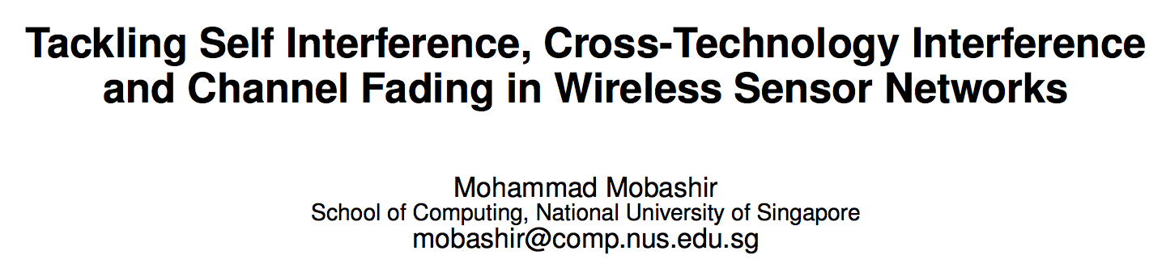
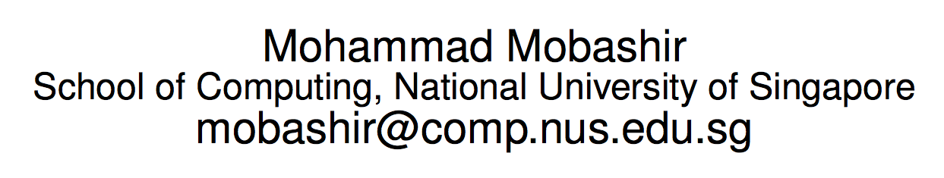
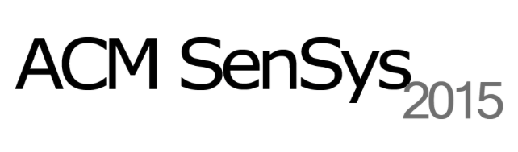
Doctoral Colloquium

Slide 2
A global trend towards IoT
Source: Cisco IBSG projections, UN Economic & Social Affairs
Notes:
We have seen a sharp increase in the number of connected devices with most of us having at least 3 like a laptop, smartphone and a tablet.
What it means is that we have a lot of wireless communication going on around us.,..

Slide 3
Severe Interference
Self Interference
Cross-Technology Interference
Collision
2.4 GHz ISM Band
Same technology devices transmit synchronously
Different Technologies share the 2.4GHz ISM band
Notes:
When we talk about interference, they are of the two forms. Self and Cross technology interference.
This is how todays presentation is roughly divided into. In the first part we tackle the self-interference followed by the more severe cross technology interference.

Slide 4
Self Interference
Collision
Same technology devices transmitting synchronously
Notes:
Lets talk about synchronous transmission which brings about the problem of self interference

Slide 5
Synchronous Transmission
2011
Efficient Network Flooding and Time Synchronization with Glossy - IPSN
LWB: Low-Power Wireless Bus - SenSys
Strawman: resolving collisions in bursty low-power wireless networks - IPSN
Splash: Fast Data Dissemination with Constructive Interference in Wireless Sensor Networks - NSDI
Chaos: Versatile and Efficient All-to-All Data Sharing and In-Network Processing at Scale - SenSys
When Pipelines Meet Fountain: Fast Data Dissemination in Wireless Sensor Networks - SenSys
2012
2013
2015
Notes:
Based on this principle, a lot of protocols have been designed which allow high throughput data transfer, low latency data collection and so on and so forth.

Slide 6
Synchronous Transmission
S₁
S₂
R₁
When δ is small
High probability of successful packet reception
Notes:
And if they are highly synchronized, there is a high probability of successful packet reception

Slide 7
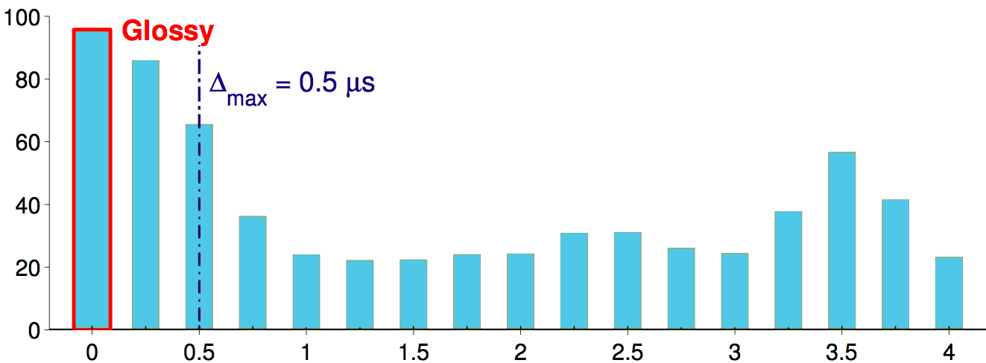

Synchronous Transmission
δ_{max} = 0.5 µs
Reliability [%]
Temporal Distance δ between two concurrent transmitters [µs]
Efficient Network Flooding and Time Synchronization with Glossy (IPSN 2011)
Notes:
The delta for synchronous transmission to be successful should be less than 0.5us.
What it means is that if any of the multiple transmitters go out of sync by even a small fraction of microsecond, due to a combination of software, hardware or signal propagation delays, the reception reliability drops significantly.

Slide 8
Synchronous Transmission
Synchronous Transmission
Low-Power Wireless Bus
LWB
Splash
P³
Chaos
Notes:
Since all these protocols are based on synchronous transmissions, having a strict timing requirement, they are not scalable.

Slide 9
Synchronous Transmission
Not Scalable
Notes:
What I mean is…

Slide 10
Scalability Problem
S₁
R
Notes:
As long as there are a few synchronous transmitters, the reliability is fine…

Slide 11
Scalability Problem
S₂
S₁
R
Notes:
As long as there are a few synchronous transmitters, the reliability is fine…

Slide 12
Scalability Problem
S₂
S₃
S₁
R
Notes:
But for large number of synchronous transmitters, the reliability reduces significantly

Slide 13
Scalability Problem
S₄
S₅
S₇
S₂
S₈
S₃
S₁
S₉
S₆
R
Notes:
But for large number of synchronous transmitters, the reliability reduces significantly

Slide 14
Scalability Problem
Indriya
Twist
Indoor
Outdoor
Notes:
From our measurements, this was not only true in different scenarios,

Slide 15
Scalability Problem
32 Bytes
64 Bytes
128 Bytes
Notes:
But also for different packet sizes, both small and large.
However, not always was a drop in reliability seen. Sometimes we also observed a rise in reception reliability…

Slide 16
Scalability Problem
Questions:
Why did it happen?
How much should Δ be?

Slide 17
Capture Effect
A receiver can decode a packet in the presence of interfering signals from concurrent transmitters if:
The signal strength from the sender is sufficiently stronger - >2x
The concurrent transmitters are sufficiently synchronized - <160μs
Capacity of Slotted ALOHA in Rayleigh-Fading Channels (JSAC 1987)
Notes:
Just a point to highlight that the level of synchronization needed for a successful capture is 160us (320 times less stringent than the previous 0.5us)

Slide 18
Syncast
Topology Construction
Syncast
Link Classification
Channel Assignment
Notes:
Thus making use of Capture Effect and Multi-Channels through channel reuse lets try to understand the design of Syncast

Slide 19
Syncast
Topology Construction
Syncast
Link Classification
Channel Assignment

Slide 20


Topology Construction
1
1
2
5
4
3
2
3
4
5
8
10
6
7
9
6
7
8
9
10
PRR = 1
PRR < 1
Notes:
And then try to construct a dissemination tree so that each node choses the best parent ( Link with strongest signal strength)

Slide 21
Syncast
Topology Construction
Syncast
Link Classification
Channel Assignment
Notes:
Now we perform link classification for each receiver as good, bad or weak.

Slide 22
Link Classification
1
1
2
3
4
5
2
3
4
5
6
7
8
9
10
6
7
8
9
10
Identify the good links having max RSSI: RSSI_{s}

Slide 23
Link Classification
1
1
2
3
4
5
2
3
4
5
6
7
8
9
10
6
7
8
9
10
Identify the bad links having RSSI ≈ ≈ RSSI_{s}
Notes:
Approximation symbol: Is π ≈

Slide 24
Link Classification
1
1
2
3
4
5
2
3
4
5
6
7
8
9
10
6
7
8
9
10
Identify the weak links having RSSI << RSSI_{s}

Slide 25
Link Classification
 | S₁ | S₂ | S₃ | S₄
R₁ | G | B | X | X
R₂ | G | B | X | X
R₃ | X | G | B | X
R₄ | X | B | B | G
R₅ | X | X | X | G
S₁
S₂
S₃
S₄
R₁
R₂
R₃
R₄
R₅
Link Classification Matrix for every hop

Slide 26
Syncast
Topology Construction
Syncast
Link Classification
Channel Assignment

Slide 27
Channel Assignment
 | S₁ | S₂ | S₃ | S₄
R₁ | G | B | X | X
R₂ | G | B | X | X
R₃ | X | G | B | X
R₄ | X | B | B | G
R₅ | X | X | X | G
S₁
S₂
S₄
S₃
Conflict Graph
Assign different channels to two nodes if they are mutually bad

Slide 28
Syncast
1
1
S₁
S₂
S₃
S₄
S₁
S₂
S₃
S₄
R₁
R₂
R₃
R₄
R₅
R₁
R₂
R₃
R₄
R₅
Finally we get a multi-channel dissemination tree
Notes:
Now the question arises whether we have so many channel available with us?

Slide 29
Feasibility
At least 4 ZigBee channels that are orthogonal to WiFi

Slide 30

Evaluation
Notes:
We evaluated it on Indriya, a 96 node network spread across three floors of an academic building

Slide 31

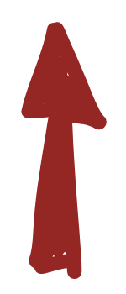
Reliability: Channel Variations

Slide 32
Reliability: Packet Size
Notes:
The reception was reliable not just for different packets size but also for different days showing the stability of the links

Slide 33
Energy Consumption
Energy Savings
52% to 92%
Notes:
This brings us to the end of the first part of Tackling self interference in WSN where we make use of capture effect over multiple channels to make synchronous transmission scalable, robust and energy efficient.

Slide 34
Cross-Technology Interference (CTI)
WiFi
ZigBee
2.4 GHz ISM Band
Bluetooth
Microwave
Different Technologies share the 2.4GHz ISM band

Slide 35
Expectation
At least 4 ZigBee channels that are orthogonal to WiFi
Notes:
Most of the existing single or multiple channel protocols expect at least 4 CTI-free ZigBee channels

Slide 36
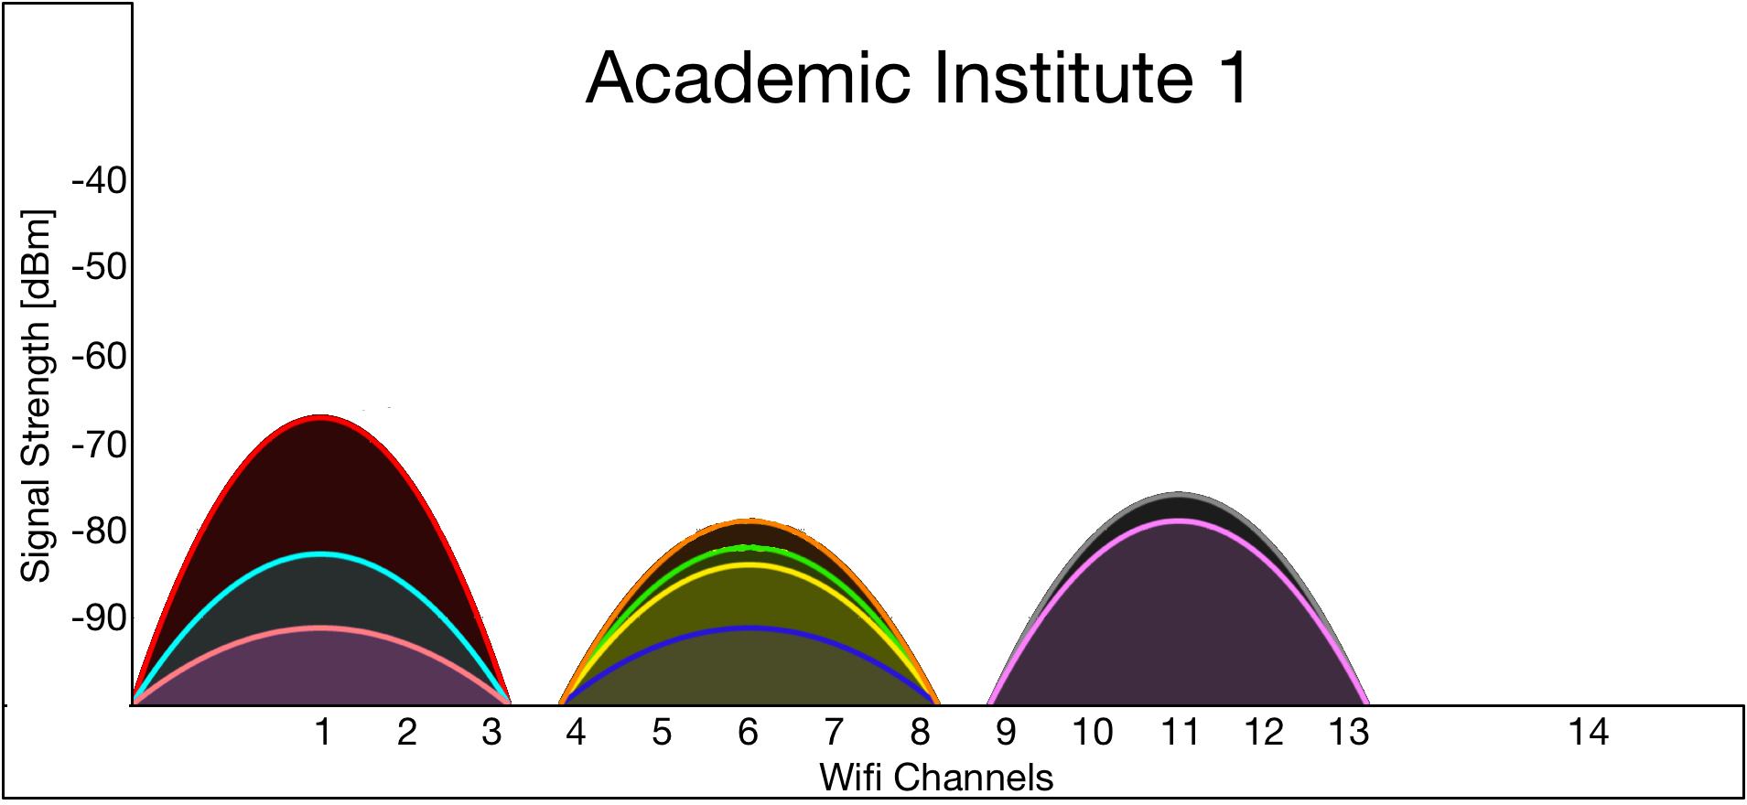
Expectation
Academic Institute

Slide 37
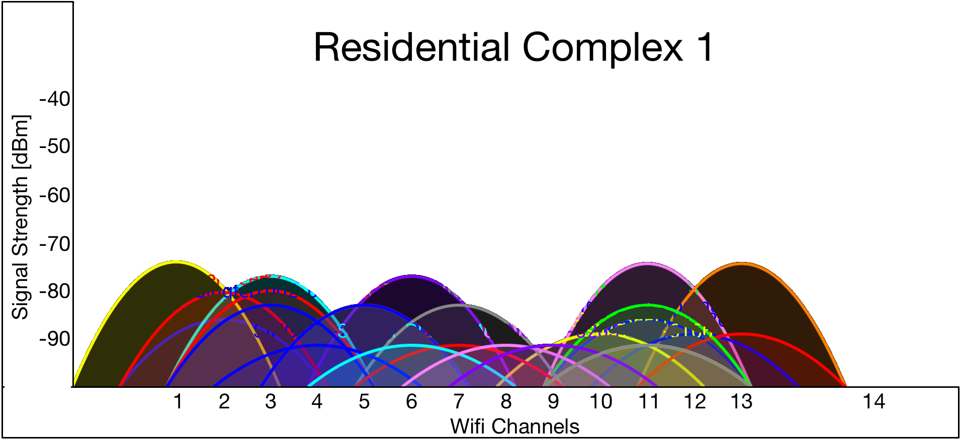
Reality
Residential Complex

Slide 38
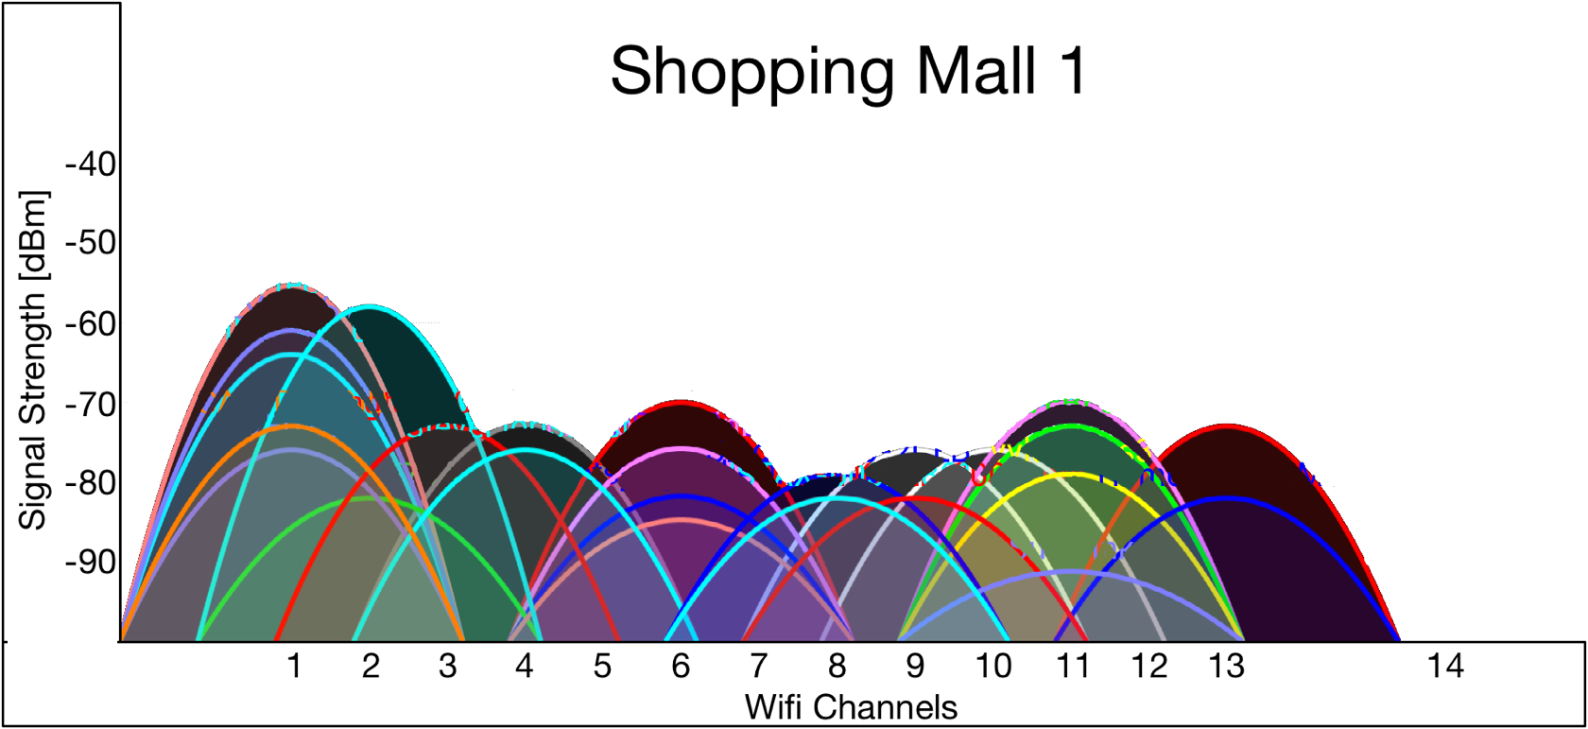
Reality
Shopping Mall

Slide 39
Traditional Approaches to handle CTI
Identify the source of interference
Tackle interference by exploiting spatial diversity
Evade interference by using channel diversity
Survive interference by adding redundancies
Notes:
The problem with these approaches is that they are very expensive

Slide 40
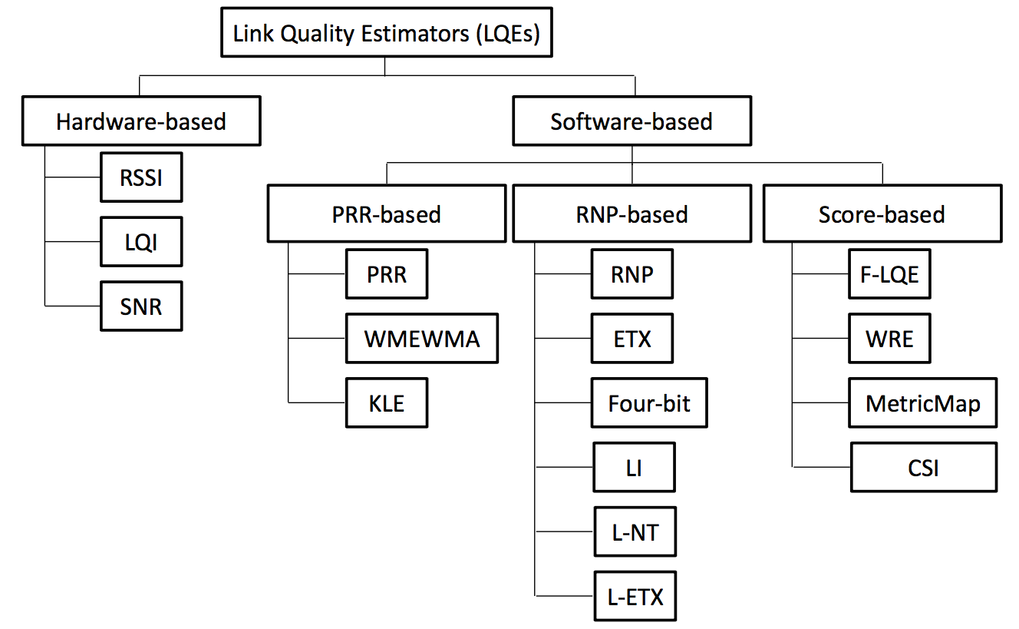
Rely on Channel/Link Quality Estimators
Radio Link Quality Estimation in Wireless Sensor Networks: a Survey

Slide 41
Traditional Approaches to handle CTI
Very expensive
Notes:
They have to rely on some kind of LQE

Slide 42
Challenges in urban deployment
Highly dynamic due to unplanned CTI
Channel Quality Estimation not feasible
Periodically Repeated
Fail to capture channel dynamics (cETX Sensys 2015)
No CTI-free channel available
No network-wide “good” channel present
Shopping Mall
Residential Complex

Slide 43
A Data Collection protocol for Dynamic Urban Environment
Eliminate expensive channel estimation
Sink
While still maintaining

Slide 44
A Data Collection protocol for Dynamic Urban Environment
Eliminate expensive channel estimation
Sink
While still maintaining
High robustness by exploiting channel diversity

Slide 45
A Data Collection protocol for Dynamic Urban Environment
Eliminate expensive channel estimation
Sink
While still maintaining
High robustness by exploiting channel diversity
Low latency by exploiting spatial diversity
Under Submission…

Slide 46
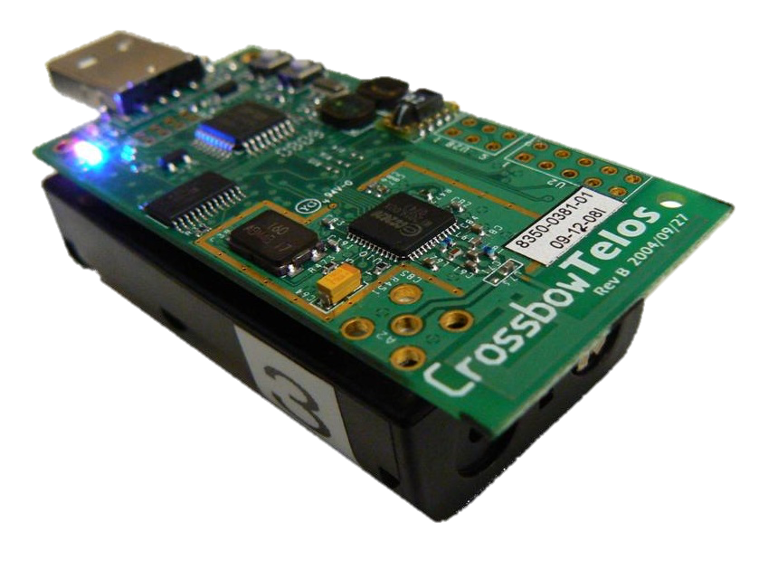
Research Impact

Slide 47
Conclusion
Scalable synchronous transmission
Capture Effect over Multi-channel
Data dissemination robust to channel variations
Up to 92% energy efficient
Robust data collection for urban environment
Eliminates the need for channel estimations
Extremely reliable and up to 2.4x energy efficient
Spatial diversity over Multi-channel

